Slide 1

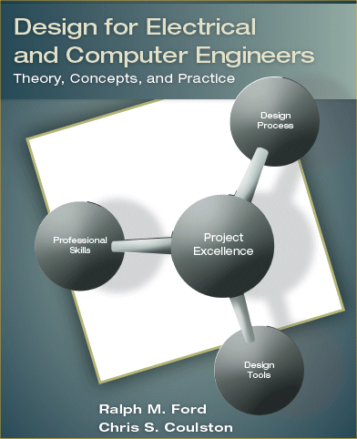

Slide 2

Team of engineers who build a system need:
An abstraction of the system
An unambiguous communication medium
A way to describe the subsystems
  Inputs
  Outputs
  Behavior
Functional Decomposition
  Function – transformation from inputs to outputs
  Decomposition – reduce to constituent parts

Slide 3

By the end of this chapter, you should:
Understand the differences between bottom-up and top-down design.
Know what functional decomposition is and how to apply it.
Be able to apply functional decomposition to different problem domains.
Understand the concept of coupling and cohesion, and how they impact design.

Slide 4

Given constituent parts
Develop a working system
  Build modules to accomplish specific tasks
  Integrate modules together into working system
For example
  Given a supply AND, OR and NOT gates.
  Build a computer
Pros
  Leads to efficient subsystem
Cons
  Complexity is difficult to manage
  Little thought to designing reusable modules
  Redesign cycles

Slide 5

Given the specification of a system
Develop a working system
  Divide the problem into abstract modules
  Reiterate until constituent parts are reached
Pros
  Highly predictable design cycle
  Efficient division of labor
Cons
  More time spent in planning

Slide 6

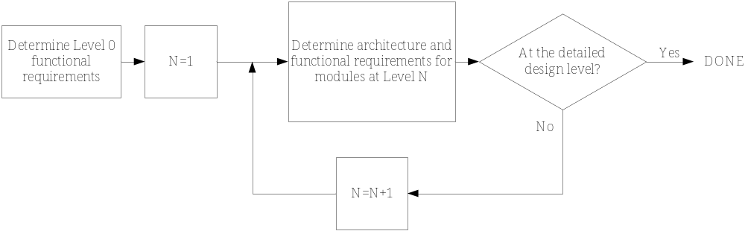
Recursively divide and conquer
  Split a module into several submodules
  Define the input, output, and behavior
  Stop when you reach realizable components

Slide 7

The design process is iterative
Upfront time saves redesign time later
Submodules should have similar complexity
Precise input, output, and behavior specifications
Look for innovation
Don’t decompose ad infinitium
Use suitable abstraction to describe submodules

Slide 8

Look at how it has been done before
Use existing technology
Keep it simple
Communicate results

Slide 9

The system must
Accept an audio input signal source with a maximum input voltage of 0.5V peak.
Have adjustable volume control between zero volume and the maximum volume level.
Deliver a maximum of 50W to an 8Ω speaker.
Be powered by a standard 120V 60Hz AC outlet.

Slide 10

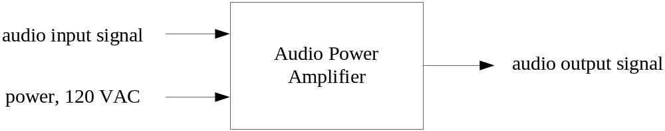
Module | Audio Power Amplifier
Inputs | Audio input signal: 0.5V peak. Power: 120 volts AC rms, 60Hz. User volume control: variable control.
Outputs | Audio output signal: ?V peak value.
Functionality | Amplify the input signal to produce a 50W maximum output signal. The amplification should have variable user control. The output volume should be variable between no volume and a maximum volume level.

Slide 11

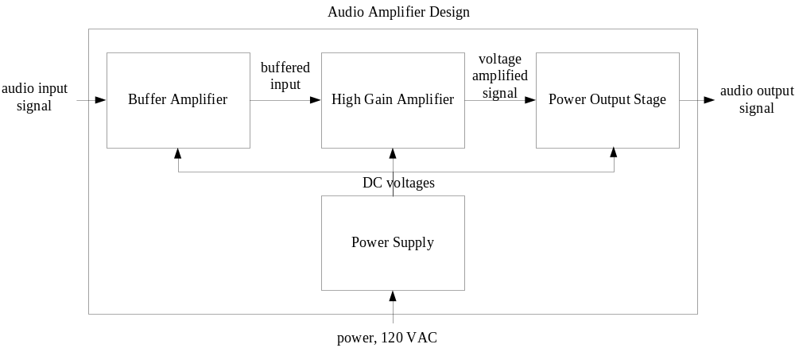

Slide 12
Module | Buffer Amplifier
Inputs | Audio input signal: 0.5V peak. Power: ± 25V DC.
Outputs | Audio signal: 0.5V peak.
Functionality | Buffer the input signal and provide unity voltage gain. It should have an input resistance >1MΩ and an output resistance <100Ω.

Slide 13
Module | High Gain Amplifier
Inputs | Audio input signal: 0.5V peak. User volume control: variable control. Power: ± 25V DC
Outputs | Audio signal: 20V peak.
Functionality | Provide an adjustable voltage gain, between 1 and 40. It should have an input resistance >100kΩ and an output resistance <100Ω.

Slide 14

Electronics Design
Digital Design
Software Design
See the book for more in-depth examples

Slide 15

The system must
Measure temperature between 0 and 200°C.
Have an accuracy of 0.4% of full scale.
Display the temperature digitally, including one digit beyond the decimal point.
Be powered by a standard 120V 60Hz AC outlet.
Use an RTD (thermal resistive device) that has an accuracy of 0.55°C over the range. The resistance of the RTD varies linearly with temperature from 100Ω at 0°C to 178Ω at 200°C.

Slide 16
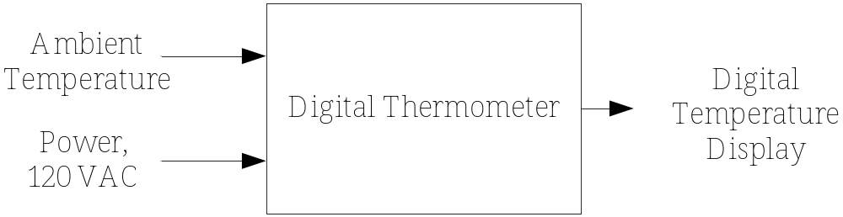

Slide 17
Module | Digital Thermometer
Inputs | Ambient temperature: 0-200°C. Power: 120V AC power.
Outputs | Digital temperature display: A four digit display, including one digit beyond the decimal point.
Functionality | Displays temperature on digital readout with an accuracy of 0.4% of full scale.

Slide 18
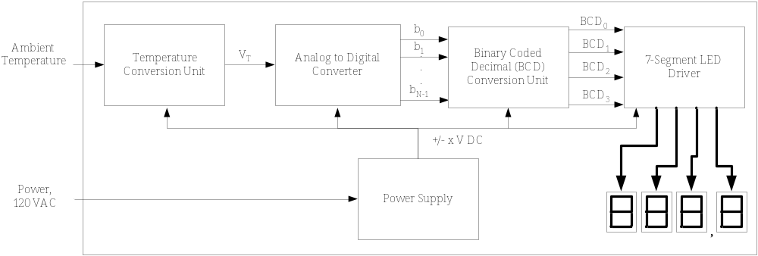

Slide 19
Module | Temperature Conversion Unit
Inputs | Ambient temperature: 0-200°C. Power: ?V DC (to power the electronics).
Outputs | V_{T}: temperature proportional voltage. V_{T}= αT, and ranges from ? to ?V.
Functionality | Produces an output voltage that is linearly proportional to temperature. It must achieve an accuracy of ?%.

Slide 20
Module | A/D Converter
Inputs | V_{T}: voltage proportional to temperature that ranges from ? to ?V. Power: ?V DC.
Outputs | b_{N-1} -b₀: ?-bit binary representation of V_{T}.
Functionality | Converts analog input to binary digital output.

Slide 21

How would you determine the unknown details in the previous 2 slides?

Slide 22

What is coupling?
How much coupling is there in the modules in the Level 1 of the previous amplifier example?
Phenomena of highly coupled systems
  A failure in 1 module propagates
  Difficult to redesign 1 module
Phenomena of low coupled systems
  Discourages reutilization of a module

Slide 23

What is cohesion?
Phenomena of highly cohesive systems
  Easy to test modules independently
  Simple (non-existent) control interface
Phenomena of low cohesive systems
  Less reuse of modules

Slide 24
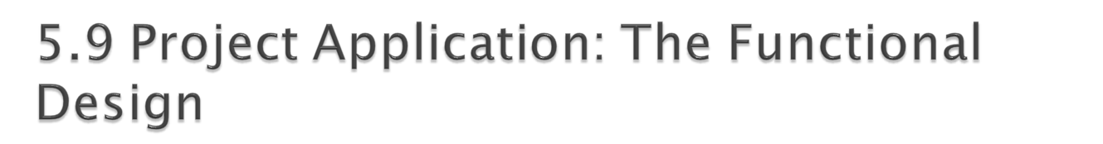
Design Level 0
  Present a single module block diagram with inputs and outputs identified.
  Present the functional requirements: inputs, outputs, and functionality.
Design Level 1
  Present the Level 1 diagram (system architecture) with all modules and interconnections shown.
  Describe the theory of operation. This should explain how the modules work together to achieve the functional objectives.
  Present the functional requirements for each module at this level.
Design Level N (for N>1)
  Repeat the process from design Level 1 as necessary.
Design Alternatives
  Describe the different alternatives that were considered, the tradeoffs, and the rationale for the choices made. This should be based upon concept evaluation methods in Chapter 4.

Slide 25

Design approach: top-down and bottom-up
Functional Decomposition
  Iterative decomposition
  Input, output, and function
  Applicable to many problem domains
Coupling – interconnectedness of modules
Cohesion – focus of modules

